Slide 1
Heart Disease Prediction using Machine Learning
Bhavya Rawat
MCA 2nd Year

Slide 2
Introduction
Heart disease remains one of the leading causes of mortality worldwide, posing significant challenges to healthcare systems globally. Early prediction and diagnosis are crucial for effective treatment and management, potentially saving countless lives. Leveraging the power of machine learning, we aim to develop predictive models that can accurately identify individuals at high risk of heart disease based on a variety of clinical and lifestyle factors.

Slide 3
Research Objective
The objective of this project is to develop accurate and reliable predictive model for heart disease using various machine learning algorithms. By analyzing patient data, including demographic, clinical, and lifestyle factors, we aim to identify individuals at high risk of developing heart disease.
Additionally, the project seeks to uncover key predictors of heart disease, providing valuable insights for preventive measures and better management strategies.

Slide 4
Primary Goals
This project aims to contribute to the ongoing efforts in this domain by developing an effective predictive model for heart disease using various machine learning algorithms. By harnessing the power of data-driven approaches, we seek to enhance the ability to identify individuals at risk of heart disease, thereby enabling healthcare professionals to intervene proactively and improve patient outcomes.
Through a comprehensive analysis of different machine learning algorithms and their performance metrics, we aim to identify the most accurate and reliable model for heart disease prediction.

Slide 5
Machine Learning Algorithms
Machine learning algorithms play a crucial role in predicting heart disease risk. Decision Trees, Logistic Regression, Random Forest, Naive Bayes, Support Vector Machine, K-Nearest Neighbors are the algorithms that have been used in order to build a powerful Prediction Model.

Slide 6
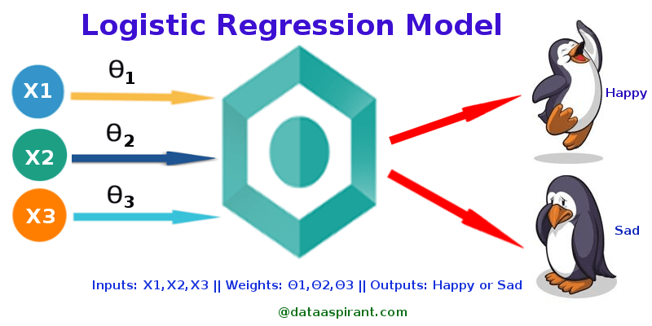
Logistic Regression
Logistic Regression is a supervised learning algorithm used for binary classification tasks. Despite its name, it's used for classification rather than regression. It models the probability that a given input belongs to a certain class using a logistic function. In Scikit-learn, Logistic Regression can handle both binary and multiclass classification problems. It works well when the relationship between features and the target variable is linear.

Slide 7
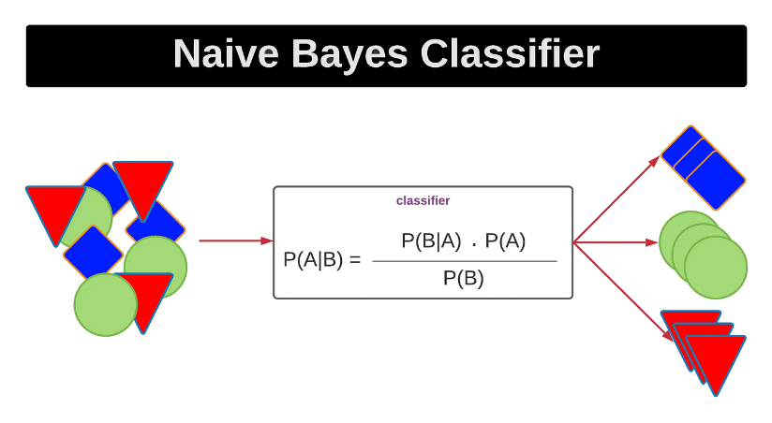
Naïve Bayes
Naive Bayes is a probabilistic classifier based on Bayes' theorem with an assumption of independence between features. Despite its simplicity, Naive Bayes classifiers often perform surprisingly well in practice, especially for text classification tasks such as spam detection and sentiment analysis. Scikit-learn provides implementations of several variants of Naive Bayes classifiers, including Gaussian Naive Bayes, Multinomial Naive Bayes, and Bernoulli Naive Bayes.

Slide 8
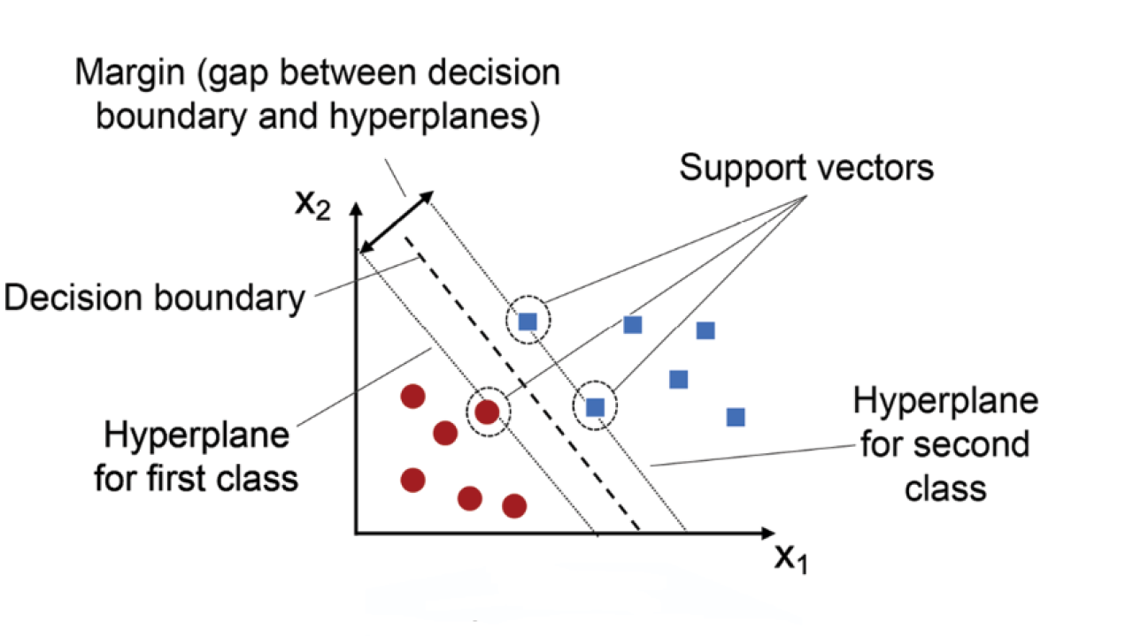
Support Vector Machine (SVM)
Support Vector Machine (SVM) is a powerful supervised learning algorithm used for classification and regression tasks. In its linear form, SVM aims to find the optimal hyperplane that separates data points of different classes with the maximum margin. This hyperplane is determined by support vectors, which are the data points closest to the decision boundary. SVMs are effective in high-dimensional spaces and can handle non-linear classification tasks through the use of kernel functions.

Slide 9
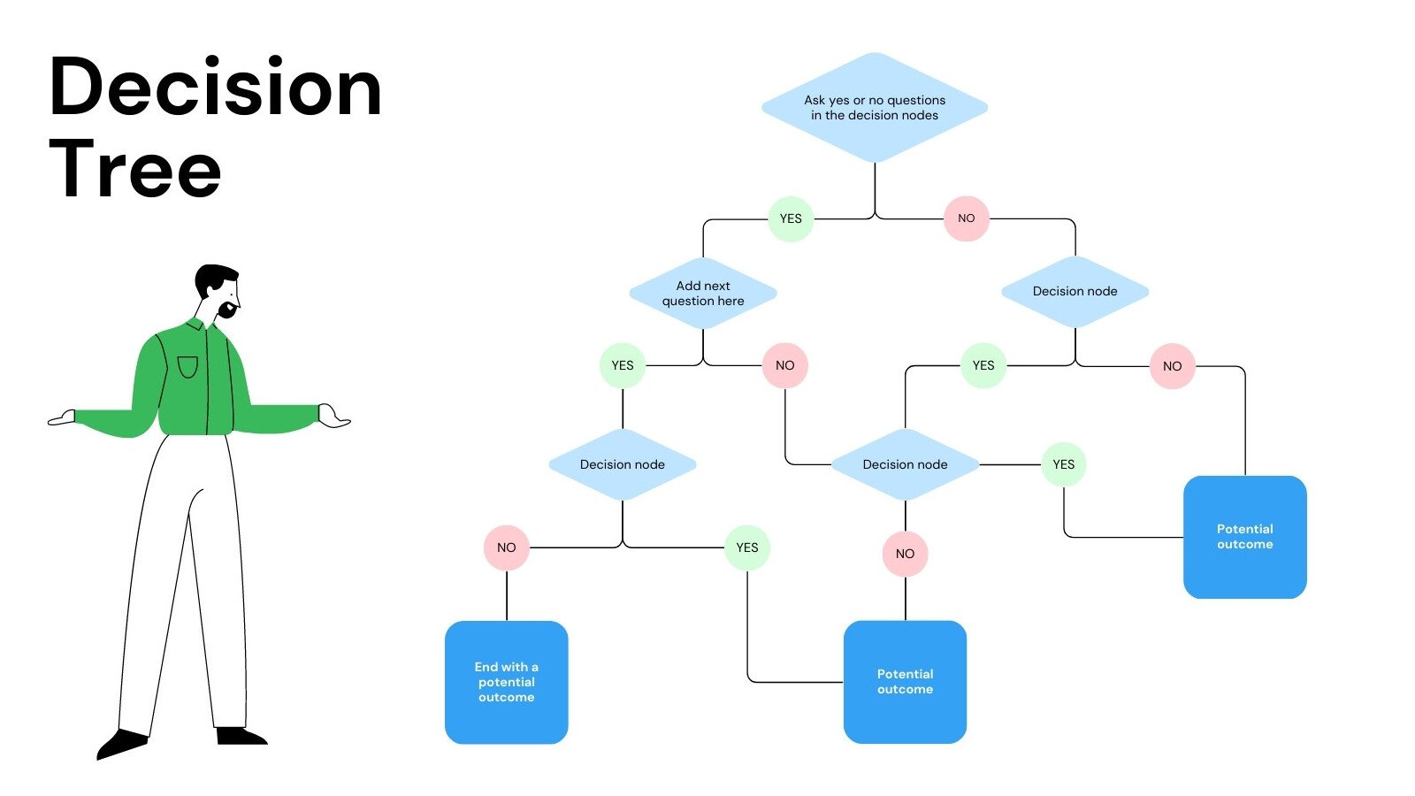
Decision Trees
Decision Tree is a versatile supervised learning algorithm used for classification and regression tasks. It works by recursively partitioning the feature space into regions that minimize impurity or maximize information gain at each node. Each partition is represented by a tree structure, where internal nodes represent decisions based on feature values and leaf nodes represent class labels or predicted values. Decision Trees are interpretable and can handle both numerical and categorical data.

Slide 10
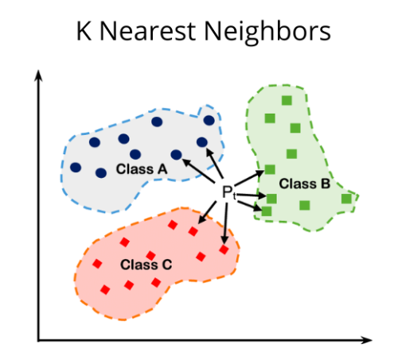
K-Nearest Neighbors
K-Nearest Neighbors (KNN) is a simple yet effective supervised learning algorithm used for classification and regression tasks. In KNN, the prediction for a new data point is made based on the majority class (for classification) or the average value (for regression) of its K nearest neighbors in the feature space. The choice of K, the number of neighbors to consider, is a crucial hyperparameter that can significantly affect the performance of the algorithm.

Slide 11
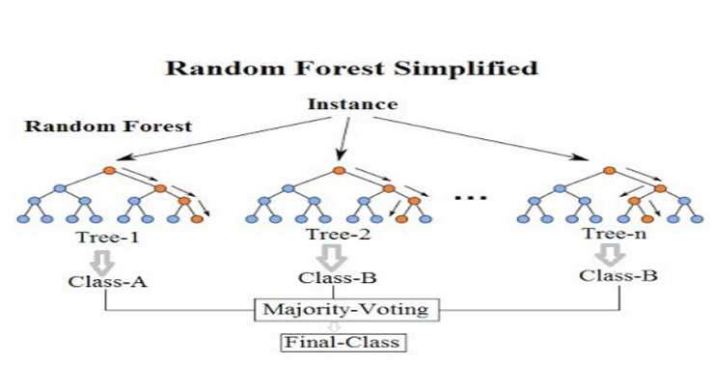
Random Forest
Random Forest is an ensemble learning method that combines multiple Decision Trees to improve predictive performance and reduce overfitting. Each tree in the Random Forest is trained on a bootstrap sample of the data, and at each split, a random subset of features is considered. The final prediction is made by averaging the predictions of all trees (for regression) or taking a majority vote (for classification). Random Forests are robust, scalable, and effective for a wide range of classification and regression tasks.

Slide 12
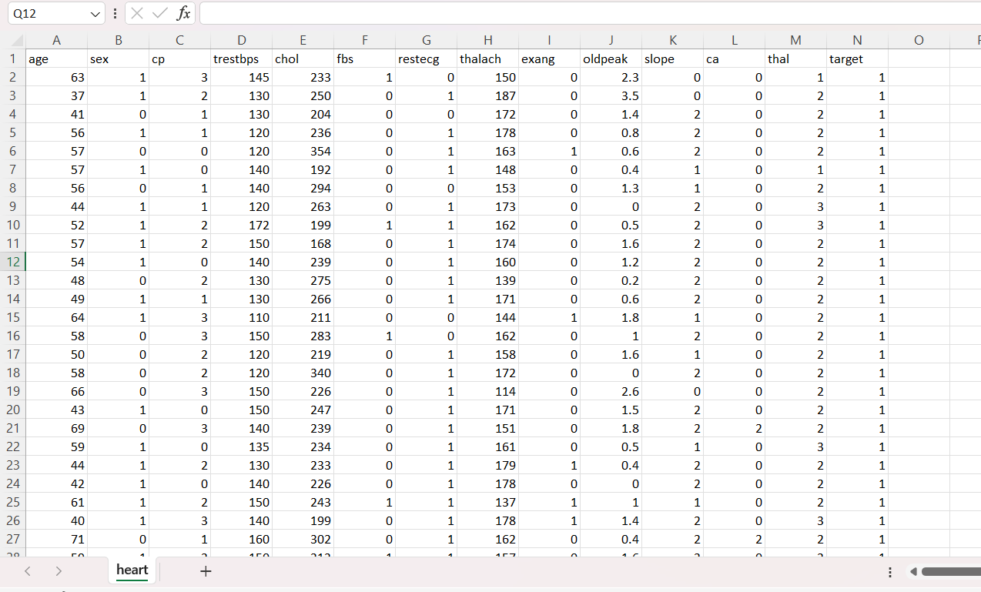
Dataset
Clinical databases have collected a significant amount of information about patients and their medical conditions. Records set with medical attributes were obtained from the Heart.csv dataset provided by @ronitf (https://www.kaggle.com/ronitf/heart-disease-uci) on Kaggle . With the help of the dataset, the patterns significant to the heart attack diagnosis are extracted. The records were split equally into two datasets: training dataset and testing dataset.
A total of 303 records with 76 medical attributes were obtained. All the attributes are numeric-valued. We are working on a reduced set of attributes, i.e., only 14 attributes

Slide 13
Attributes of the Dataset
The dataset used in this project is sourced from a collection of patient records, containing various features relevant to heart disease prediction. Each record corresponds to an individual patient and includes the following attributes:
S. No | Attribute | Description
1 | Age | age in years
2 | Sex | (1 = male; 0 = female)
3 | Cp | Chest Pain
4 | Trest Bps | resting blood pressure (in mm Hg on admission to the hospital)
5 | Chol | serum cholesterol in mg/d
6 | Fbs | (Fasting blood sugar >120 mg/dl) (1 = true; 0 = false)
7 | Restecg | Resting electrocardiographic results
8 | Thalach | Maximum heart rate achieved
9 | Exang | Exercise induced angina (1=yes;0=no)
10 | Old Peak | ST depression induced by exercise relative to rest
11 | Slope | The slope of the peak exercise ST segment
12 | Ca | Number of major vessels (0-3) colored by fluoroscopy
13 | Thal | 1 = normal; 2 = Fixed defect; 3 = reversible fluoroscopy
14 | Target | 1 or 0

Slide 14
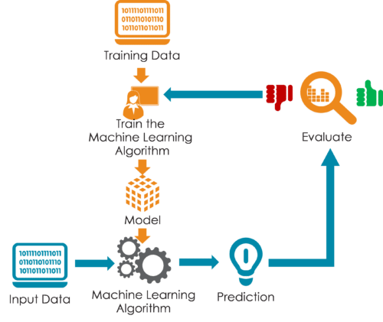
Methodology
Data Collection and Preprocessing
Exploratory Data Analysis (EDA)
Feature Engineering
Algorithm Selection and Implementation
Model Training and Evaluation
Algorithm Comparison and Selection
Model Interpretation and Explainability

Slide 15
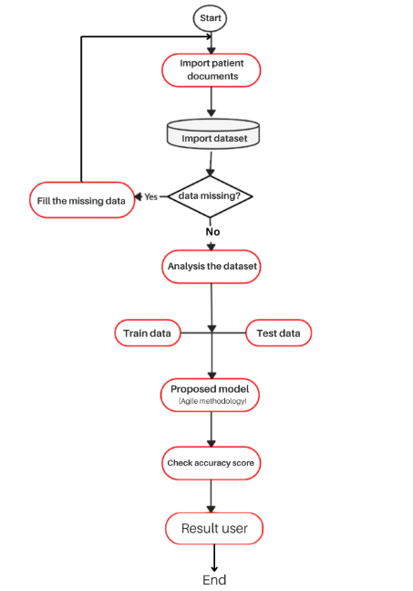
Work Flow Diagram

Slide 16
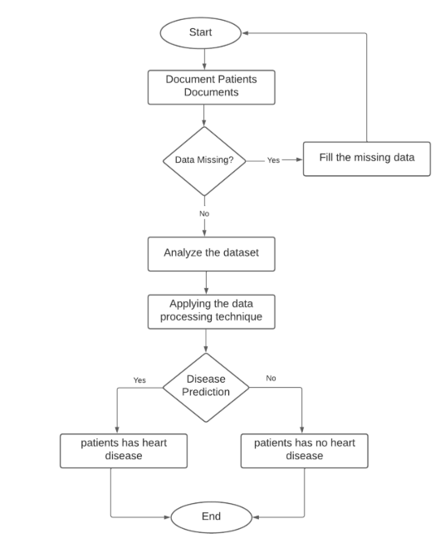
Flow Chart

Slide 17


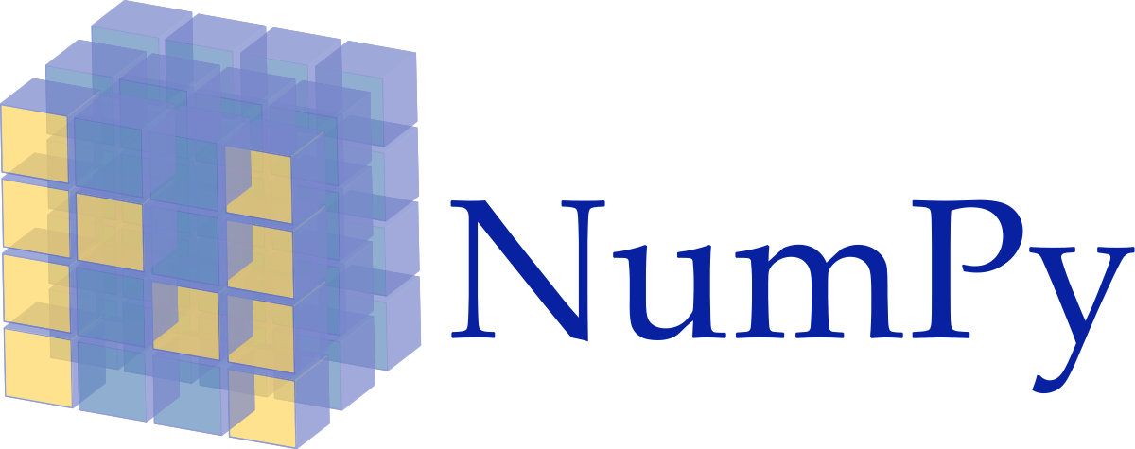
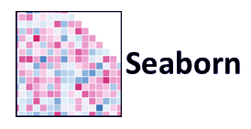

Libraries Used

Slide 18
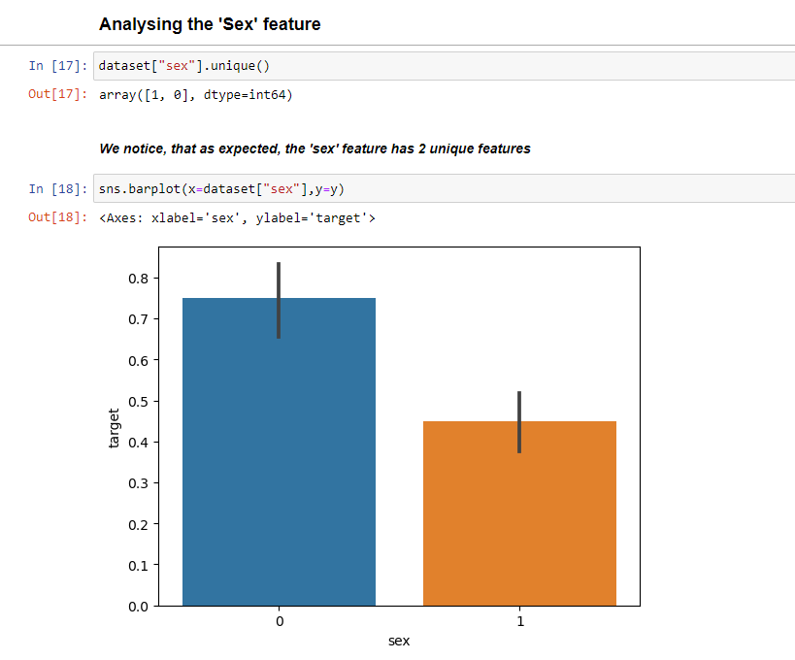
Exploratory Data Analysis
Bar Graphs Plotted for all the attributes:
Sex Feature :
The bar for females (sex = 0) is higher than the bar for males (sex = 1).
This indicates that a higher proportion of females in this dataset have heart disease compared to males

Slide 19
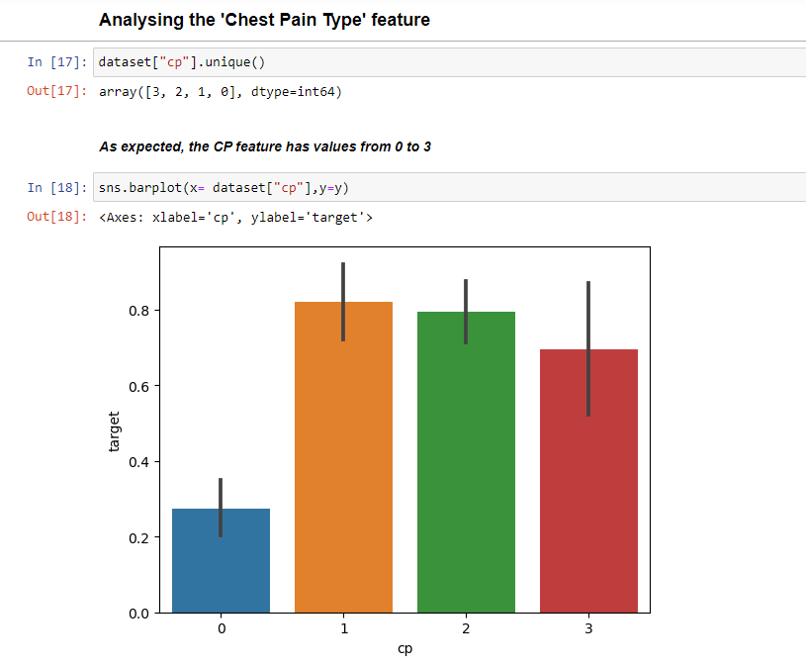
Exploratory Data Analysis
Chest Pain (CP) Feature:
Chest pain type (0 = typical angina, 1 = atypical angina, 2 = non-anginal pain, 3 = asymptomatic)
Chest pain type (cp) has a significant association with the presence of heart disease, with atypical angina, non-anginal pain, and asymptomatic chest pain showing a higher presence of heart disease.

Slide 20
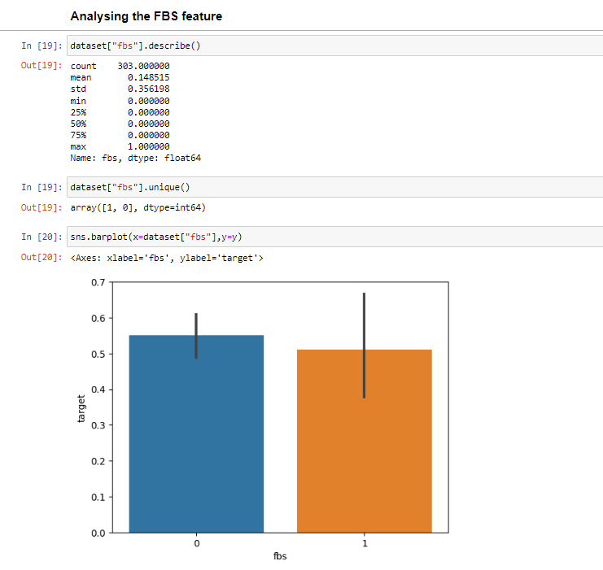
Exploratory Data Analysis
Fasting Blood Sugar (fbs) Feature:
Fasting blood sugar (fbs) does not show a strong association with heart disease, as both categories have similar average target values.

Slide 21
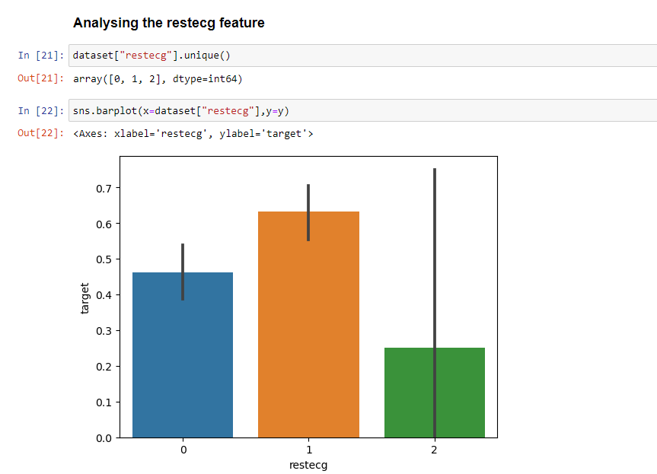
Exploratory Data Analysis
Resting Electrocardiographic Results (restecg) feature:
Here 0 refers to Normal , 1 refers to having ST-T wave abnormality and 2 refers to showing definite left ventricular hypertrophy
We realize that people with restecg '1' and '0' are much more likely to have a heart disease than with restecg '2'

Slide 22
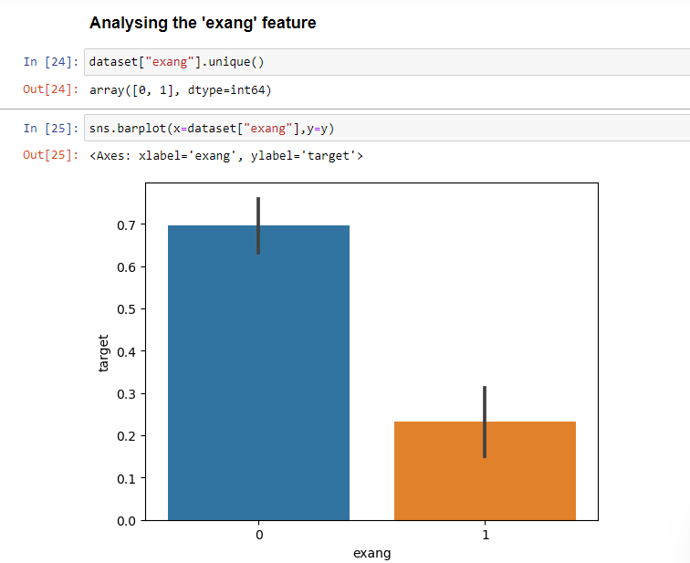
Exploratory Data Analysis
Exercise- Induced Angina(exang) feature:
Individuals without exercise-induced angina(ex=0) have a higher proportion of heart disease. This suggests that even in the absence of exercise-induced angina, individuals may still have a significant risk of heart disease.

Slide 23
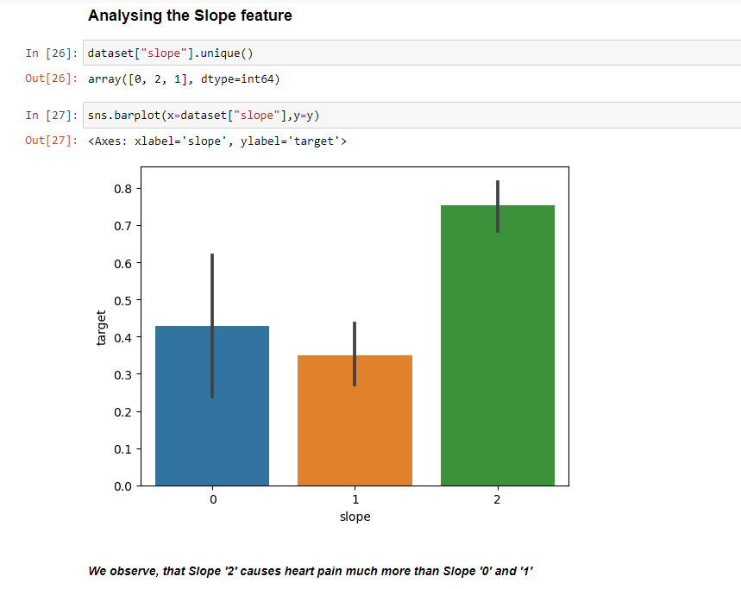
Exploratory Data Analysis
Slope feature:
Here 0 refers to upsloping, 1 refers to flat and 2 refers to downsloping.
Patients with a "slope" of 2 may be at a higher risk for the target condition compared to those with a slope of 0 or 1.

Slide 24
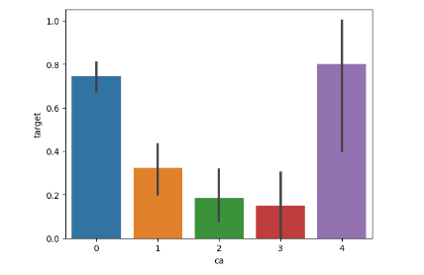
Exploratory Data Analysis
Number of Major Vessels Colored by Fluoroscopy (ca) feature
The higher the number of major vessels, the higher the probability of heart disease, as indicated by the increasing proportion of the target variable. This is consistent with medical knowledge that a higher number of major vessels indicates more blockage and increased risk of heart disease . Here we can clearly see that “ca=4” has astonishingly large number of heart patients.

Slide 25
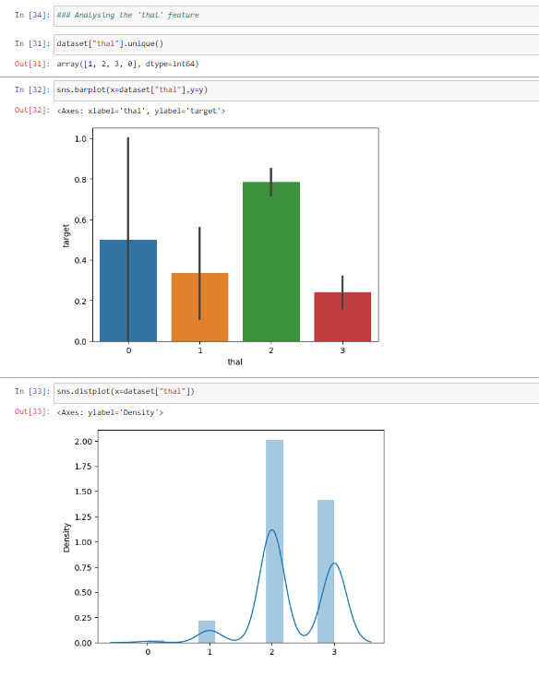
Exploratory Data Analysis
“Thalassemia” (thal) feature:
Here 1 refers to normal, 2 refers to fixed defect and 3 refers to reversible defect
The graph indicates that there is a significant relationship between the thalassemia status and the risk of heart disease. Patients with a "thal" value of 2 may be at a higher risk for the target condition compared to those with a "thal" value of 1. This supports the importance of considering blood disorders such as thalassemia when evaluating heart disease risk.

Slide 26
ALGORITHMS EXPLANATION

Slide 27
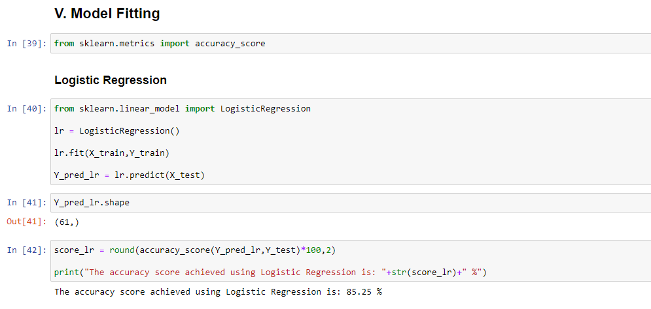
Logistic Regression

Slide 28
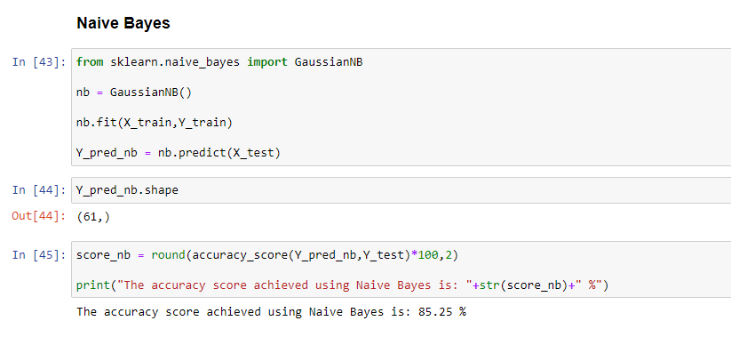
Naïve Bayes

Slide 29
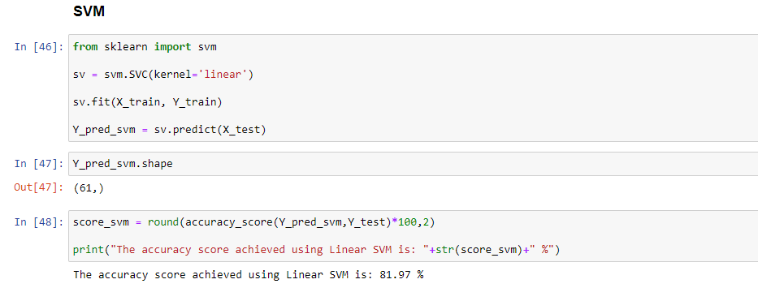
Support Vector Machine(SVM)

Slide 30
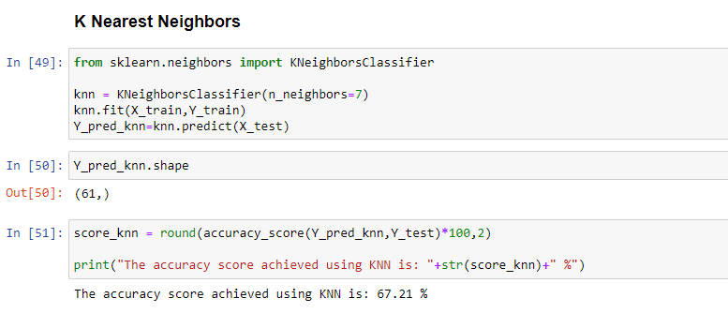
K-Nearest Neighbors

Slide 31
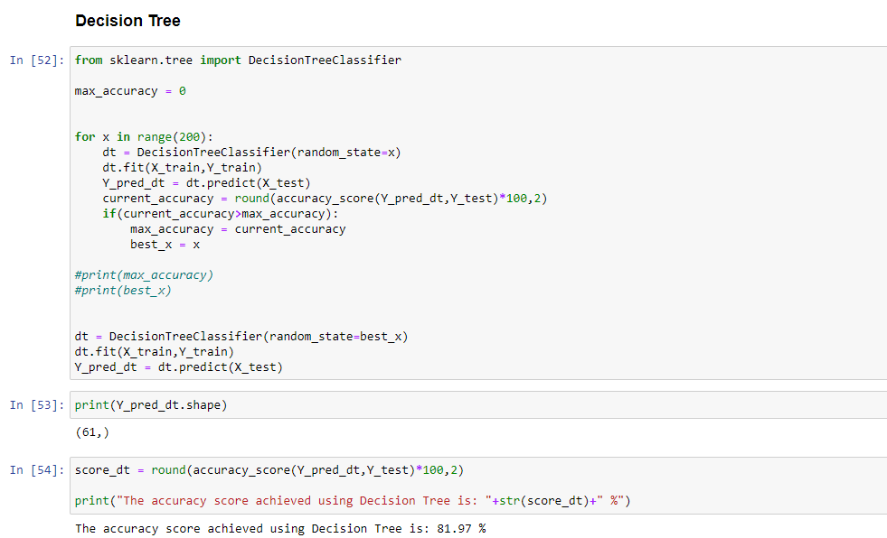
Decision Trees

Slide 32
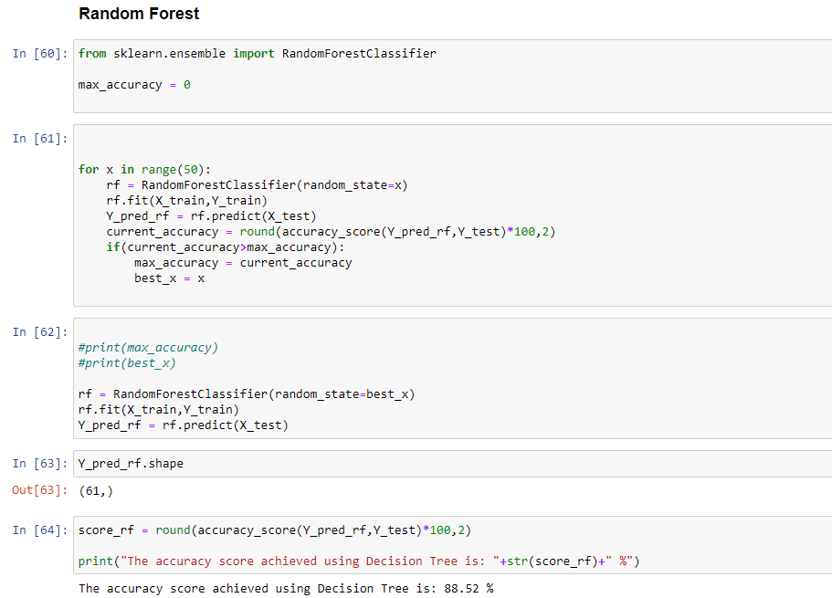
Random Forest

Slide 33
FINAL OUTPUT

Slide 34
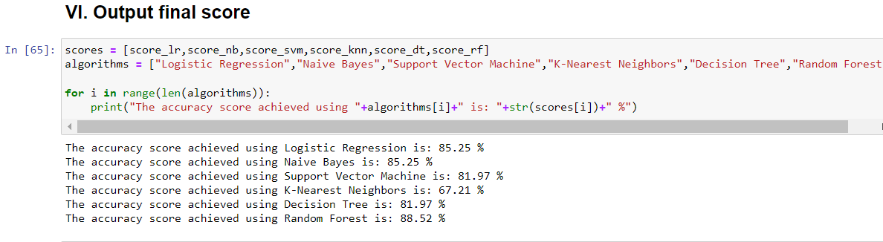

Slide 35
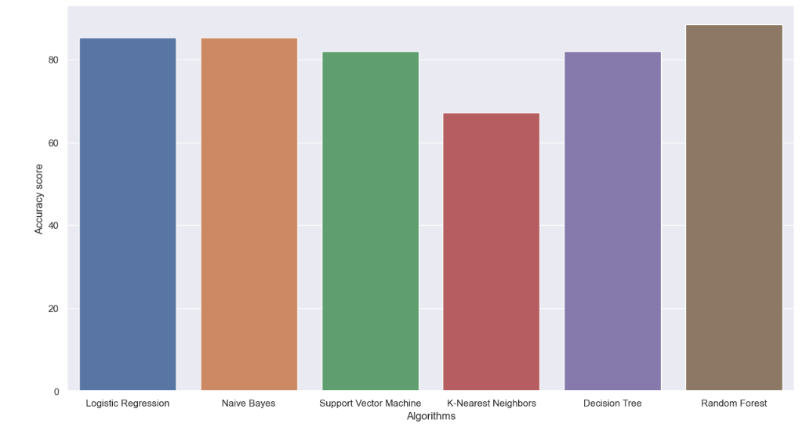
It shows that Random Forest algorithm has more accuracy than Other Machine Learning Algorithms from the dataset values and also shows the accuracy percentage of Random Forest Algorithm along with other algorithms.

Slide 36
Conclusion
This project demonstrates the significant potential of machine learning in predicting heart disease, leveraging a variety of algorithms to analyze patient data and identify individuals at high risk. Through the implementation and evaluation of models such as logistic regression, decision trees, support vector machines, we have been able to determine the most effective techniques for accurate prediction. The insights gained from this study, including the identification of key predictors such as age, cholesterol levels, and blood pressure, underscore the importance of data-driven approaches in healthcare. By enhancing early detection and enabling timely interventions, our predictive model can contribute to improved patient outcomes and more efficient use of healthcare resources.
Future work will focus on refining these models, incorporating additional data sources, and exploring the integration of these tools into clinical practice to further advance heart disease prevention and management.
Among the models tested, the Random Forest classifier achieved the highest accuracy, indicating that it is the most effective model for predicting heart disease in this dataset.

Slide 37
THANK YOU

